Slide 1

Part I (Summary):
MF Recommendation Retrieval as Similarity Search Problem

Slide 2
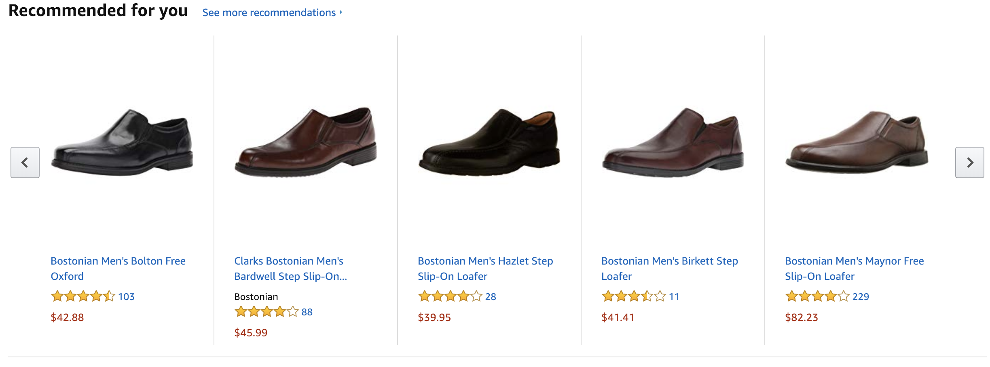

Solution: Recommender Systems

Slide 3


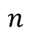
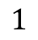
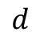



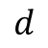
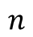
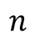
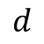


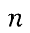
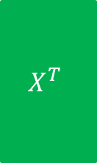
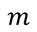
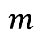
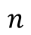

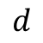


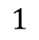


Two Phases of a MF Recommender System
$$n$$
$$d$$
$$n$$
$$R$$
$$X^{T}$$
$$Y$$
Learning
phase
$$m$$
$$≈$$
$$m$$
$$×$$
$$d$$
$$n$$
$$pref_{u}\left(i\right)=x_{u}^{T}{.y}_{i}$$
$$d$$
$$Y$$
$$n$$
$$×$$
$$d$$
$$=$$
$$pref_{u}$$
$$1$$
$$x_{u}$$
$$1$$
Retrieval
phase
$$n$$
Top-K items
$$1$$
Sorted $pref_{u}$

Slide 4
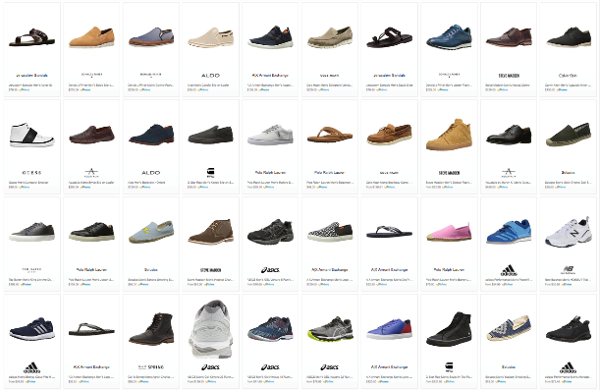
Choice Explosion
133,520 results for ”Men’s Shoes"

Slide 5
Scalable Recommendation Retrieval
Linear scanning may not be scalable for real-time retrieval
Indexing schemes do not work out-of-the-box for Maximum Inner Product Search (MIPS)
Strategy #1: Approximate MIPS
Learn the latent vectors from matrix factorization as usual
Apply post-hoc treatment or transformations to those vectors to enable approximation
Strategy #2: Indexable Representation
Design new matrix factorization techniques that would output natively indexable latent vectors
Compatible with LSH, spatial trees, or inverted index
Strategy #3: Discrete Representation
Learn a different representation altogether, e.g., binary codes
Inherently compatible with Hamming ranking or hashtable lookup

Slide 6
Part II A:
Approaches for Scalable Recommendation Retrieval
Approximate Maximum Inner Product Search
Slides available at
https://code.preferred.ai/recommendation-retrieval

Slide 7
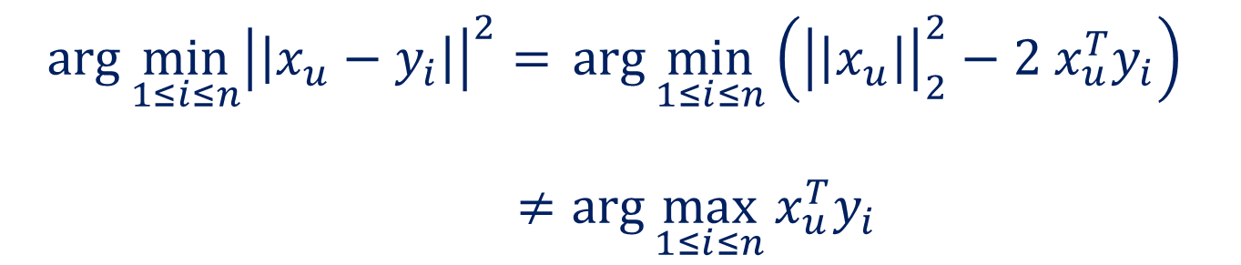
Maximum Inner Product Search?
Shrivastava and Li, "Asymmetric LSH (ALSH) for Sublinear Time Maximum Inner Product Search (MIPS)", NIPS 2014.
(MIPS) Given a query $x_{u}$, determine the index $i$:
$$i=\arg{\max_{1≤i≤n}{x_{u}^{T}y_{i}}}$$
MIPS is not the same as classical NNS
$$\arg{\min_{1≤i≤n}{{\left|\left|x_{u}−y_{i}\right|\right|}^{2}}= }\arg{\min_{1≤i≤n}\left({\left|\left|x_{u}\right|\right|}_{2}^{2}−2 x_{u}^{T}y_{i}\right) }$$
$≠\arg{\max_{1≤i≤n}{x_{u}^{T}y_{i}}}$

Slide 8
Overview
Approximate MIPS
Candidate Filtering with Indexing
Quantization-based
Sampling
Sequential Scanning
Locality Sensitive Hashing
Inverted Indexing

Slide 9
Overview
Reduce the number of investigated items
Indexing
Sampling
Sequential Scanning
Reduce the cost of a preference computation
Quantization-based

Slide 10
1.1 Indexing – Locality Sensitive Hashing

Slide 11

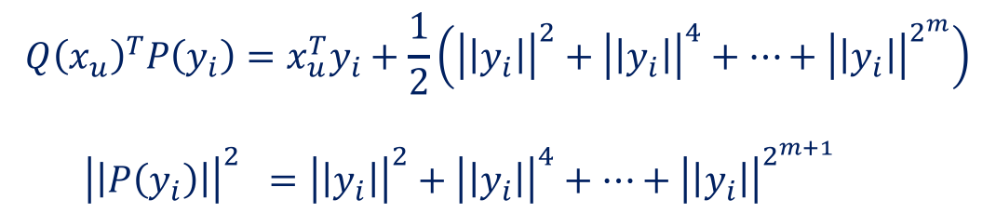
L2-Asymmetric LSH for MIPS
Shrivastava and Li, "Asymmetric LSH (ALSH) for Sublinear Time Maximum Inner Product Search (MIPS)", NIPS 2014.
User transformation
Item transformation
$$P\left(y_{i}\right)=\left[y_{i},{\left|\left|y_{i}\right|\right|}^{2},{\left|\left|y_{i}\right|\right|}^{4}, ….,{\left|\left|y_{i}\right|\right|}^{2^{m}}\right]$$
$$Q\left(x_{u}\right)=\left[x_{u},0, 0, ….,0\right]$$
$$\left(\left|\left|y_{i}\right|\right|<1, ∀y_{i}∈Y\right)$$
Observation
$$Q{\left(x_{u}\right)}^{T}P\left(y_{i}\right)=x_{u}^{T}y_{i}+\frac{1}{2}\left({\left|\left|y_{i}\right|\right|}^{2}+{\left|\left|y_{i}\right|\right|}^{4}+…+{\left|\left|y_{i}\right|\right|}^{2^{m}}\right)$$
${\left|\left|P\left(y_{i}\right)\right|\right|}^{2} ={\left|\left|y_{i}\right|\right|}^{2}+{\left|\left|y_{i}\right|\right|}^{4}+…+{\left|\left|y_{i}\right|\right|}^{2^{m+1}}$
Reducing MIPS to Nearest Neighbor Search

Slide 12

L2-Asymmetric LSH for MIPS
Shrivastava and Li, "Asymmetric LSH (ALSH) for Sublinear Time Maximum Inner Product Search (MIPS)", NIPS 2014.
User transformation
Item transformation
$$P\left(y_{i}\right)=\left[y_{i},{\left|\left|y_{i}\right|\right|}^{2},{\left|\left|y_{i}\right|\right|}^{4}, ….,{\left|\left|y_{i}\right|\right|}^{2^{m}}\right]$$
$$Q\left(x_{u}\right)=\left[x_{u},0, 0, ….,0\right]$$
$$\left(\left|\left|y_{i}\right|\right|<1, ∀y_{i}∈Y\right)$$
Observation
${\left|\left|Q\left(x_{u}\right)− P\left(y_{i}\right) \right|\right|}^{2} =\left(1+\frac{m}{4}\right) −2 x_{u}^{T}y_{i}+{\left|\left|y_{i}\right|\right|}^{2^{\left(m+1\right)}}$
$\arg{\max{x_{u}^{T}y_{i} \sim \arg{\min{{\left|\left|Q\left(x_{u}\right)−P\left(y_{i}\right)\right|\right|}^{2}}}}}$
Reducing MIPS to Nearest Neighbor Search

Slide 13
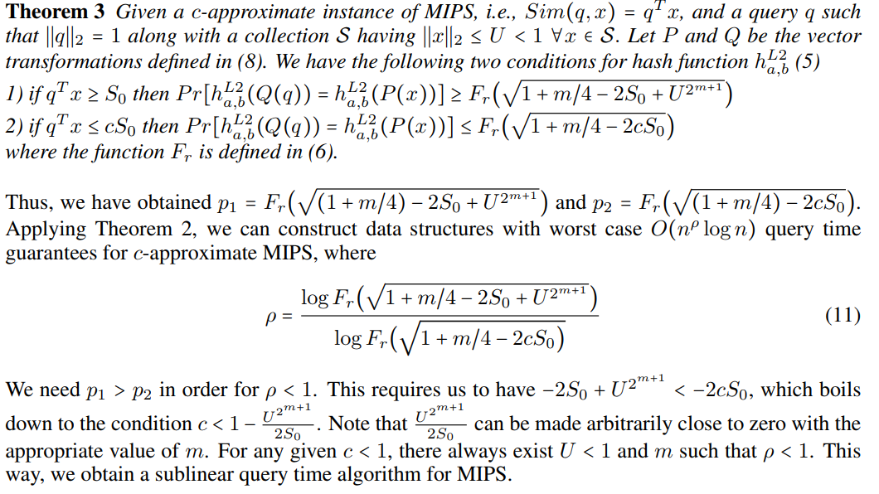
L2-Asymmetric LSH is efficient for MIPS
Shrivastava and Li, "Asymmetric LSH (ALSH) for Sublinear Time Maximum Inner Product Search (MIPS)", NIPS 2014.

Slide 14
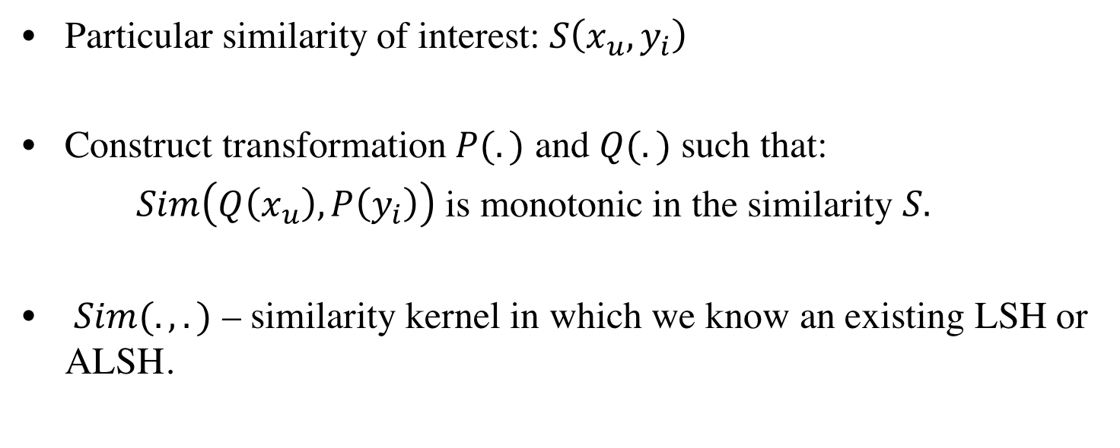
A Generic Recipe for Constructing Asymmetric LSHs
Particular similarity of interest: $S\left(x_{u}, y_{i}\right)$
Construct transformation $P(.)$ and $Q(.)$ such that:
$Sim\left(Q\left(x_{u}\right), P\left(y_{i}\right)\right)$ is monotonic in the similarity $S.$
$Sim(.,.)$ – similarity kernel in which we know an existing LSH or ALSH.

Slide 15
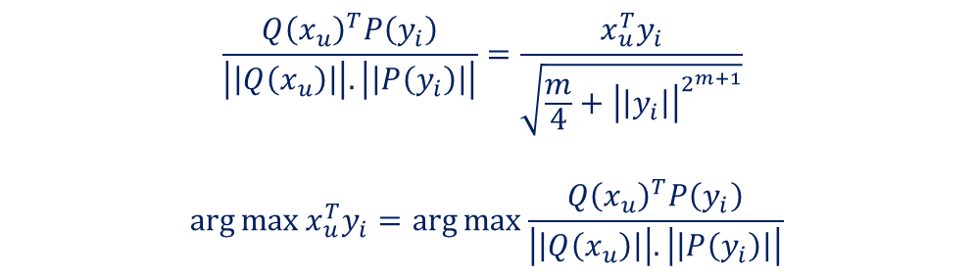

Sign-ALSH for MIPS
Shrivastava and Li, "Improved Asymmetric Locality Sensitive Hashing (ALSH) for Maximum Inner Product Search (MIPS)", UAI 2015.
User transformation
Item transformation
$$P\left(y_{i}\right)=\left[y_{i},{\frac{1}{2}−\left|\left|y_{i}\right|\right|}^{2},\frac{1}{2}−{\left|\left|y_{i}\right|\right|}^{4}, ….,{\frac{1}{2}−\left|\left|y_{i}\right|\right|}^{2^{m}}\right]$$
$$Q\left(x_{u}\right)=\left[x_{u},0, 0, ….,0\right]$$
$$\left(\left|\left|y_{i}\right|\right|<1, ∀y_{i}∈Y\right)$$
Observation
$$\frac{Q{\left(x_{u}\right)}^{T}P\left(y_{i}\right)}{\left|\left|Q\left(x_{u}\right)\right|\right|.\left|\left|P\left(y_{i}\right)\right|\right|}=\frac{x_{u}^{T}y_{i}}{\sqrt{\frac{m}{4}+{\left|\left|y_{i}\right|\right|}^{2^{m+1}}}}$$
$$\arg{\max{x_{u}^{T}y_{i}}=\arg{\max{\frac{Q{\left(x_{u}\right)}^{T}P\left(y_{i}\right)}{\left|\left|Q\left(x_{u}\right)\right|\right|.\left|\left|P\left(y_{i}\right)\right|\right|}}}}$$
Reducing MIPS to Maximum Cosine Similarity Search

Slide 16
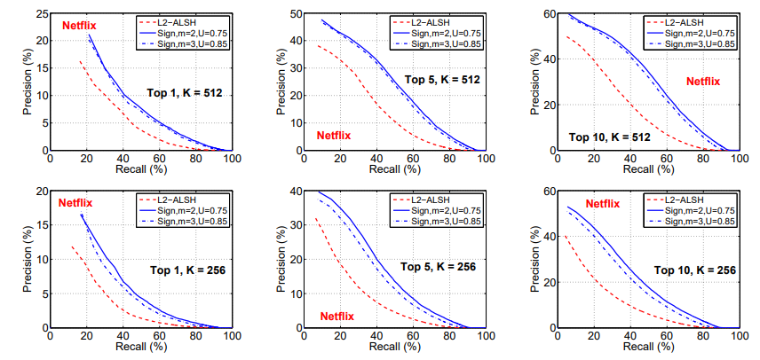
Sign-ALSH for MIPS
Shrivastava and Li, "Improved Asymmetric Locality Sensitive Hashing (ALSH) for Maximum Inner Product Search (MIPS)", UAI 2015.

Slide 17
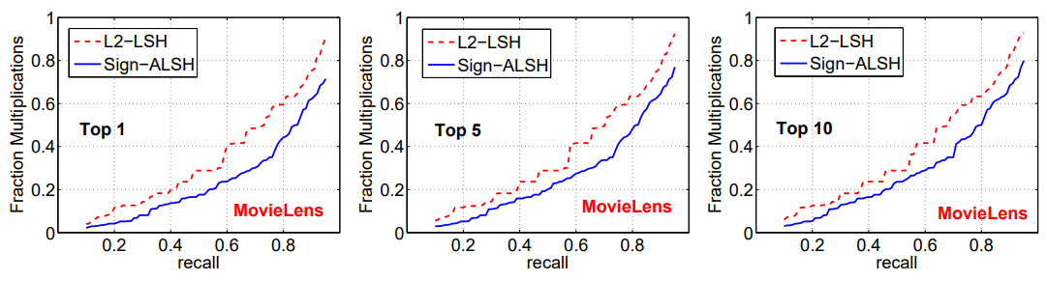
Sign-ALSH for MIPS
Shrivastava and Li, "Improved Asymmetric Locality Sensitive Hashing (ALSH) for Maximum Inner Product Search (MIPS)", UAI 2015.

Slide 18
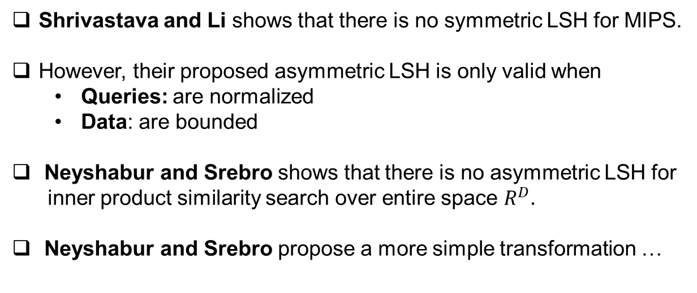
Simple-LSH for MIPS
Shrivastava and Li shows that there is no symmetric LSH for MIPS.
However, their proposed asymmetric LSH is only valid when
Queries: are normalized
Data: are bounded
Neyshabur and Srebro shows that there is no asymmetric LSH for
inner product similarity search over entire space $R^{D}.$
Neyshabur and Srebro propose a more simple transformation …
Neyshabur and Srebro, "On Symmetric and Asymmetric LSHs for Inner Product Search", ICML 2015.

Slide 19


Simple-LSH for MIPS
Pre-Processing
$$\left|\left|y_{i}\right|\right|≤M, ∀y_{i}∈Y$$
$$Q\left(x_{u}\right)=\left[x_{u},0\right]$$
$$P\left(y_{i}\right)=\left[y_{i},\sqrt{M^{2}−{\left|\left|y_{i}\right|\right|}^{2}}\right]$$
Reducing MIPS to NNS/MCSS
$$\arg{\max_{1≤i≤n }{x_{u}^{T}y_{i}=\arg{\min_{1≤i≤n }\left|\left|Q\left(x_{u}\right)−P\left(y_{i}\right)\right|\right|= \arg{\max_{1≤i≤n }{\frac{Q{\left(x_{u}\right)}^{T}P\left(y_{i}\right)}{\left|\left|Q\left(x_{u}\right)\right|\right|.\left|\left|P\left(y_{i}\right)\right|\right|}}}}}}$$
[1] Bachrach, Y., et al. Speeding up the Xbox recommender system using a euclidean transformation for inner-product spaces. RecSys 2014.
[2] Neyshabur and Srebro, "On Symmetric and Asymmetric LSHs for Inner Product Search", ICML 2015.

Slide 20
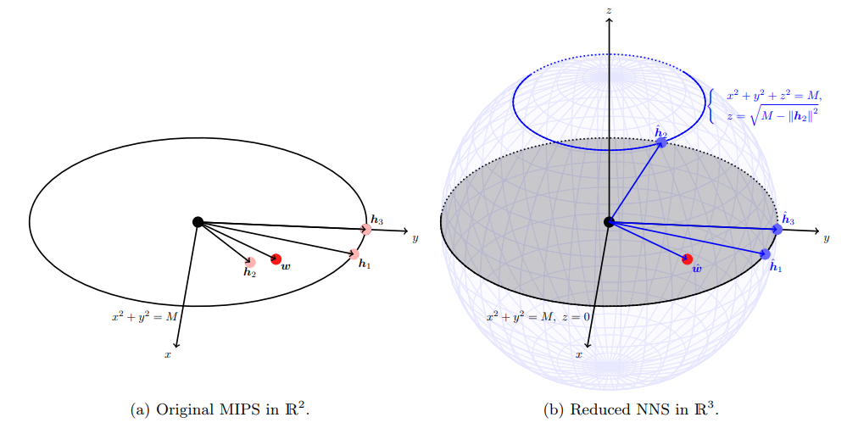
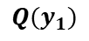
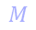
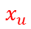
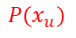
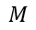
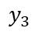
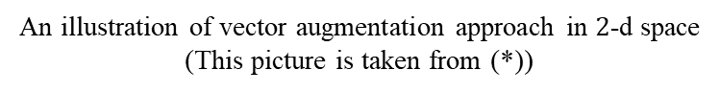
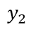
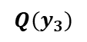
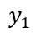
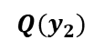
Xbox Transformation
$$M$$
$${Q(y}_{1})$$
$$M$$
$$y_{3}$$
$${Q(y}_{3})$$
$$x_{u}$$
$$y_{2}$$
$$P(x_{u})$$
$${Q(y}_{2})$$
$$y_{1}$$
$$M$$
$$M$$
An illustration of vector augmentation approach in $2$-d space
(This picture is taken from (*))
(*) Yu, H., Hsieh, C., Lei, Q., & Dhillon, I.S. (2017). A Greedy Approach for Budgeted Maximum Inner Product Search. NIPS.

Slide 21
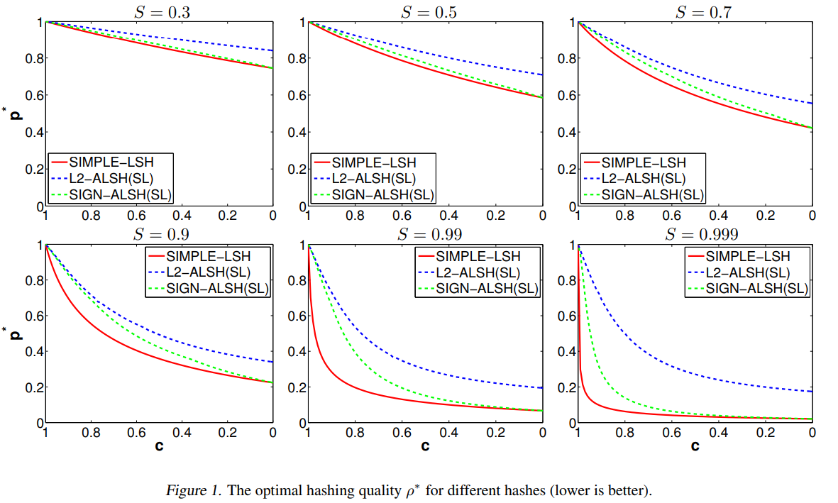
Simple-LSH for MIPS
Neyshabur and Srebro, "On Symmetric and Asymmetric LSHs for Inner Product Search", ICML 2015.

Slide 22
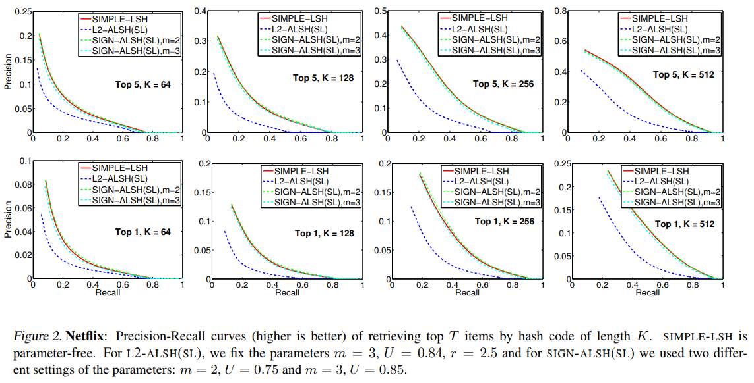
Simple-LSH for MIPS
Neyshabur and Srebro, "On Symmetric and Asymmetric LSHs for Inner Product Search", ICML 2015.

Slide 23
Simple-LSH for MIPS
Neyshabur and Srebro, "On Symmetric and Asymmetric LSHs for Inner Product Search", ICML 2015.

Slide 24
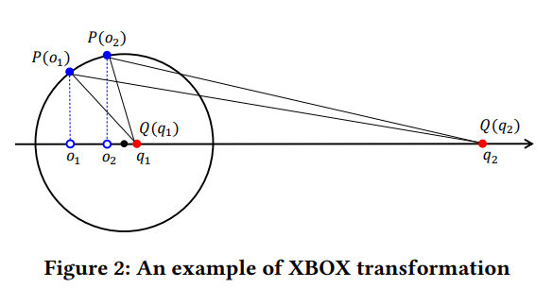



Drawbacks of Xbox Transformation
$$P\left(o\right)=\left[o,\sqrt{M^{2}−{\left|\left|o\right|\right|}^{2}}\right]$$
$$Q\left(q\right)=\left[q,0\right]$$
For $\left|\left|q_{1}\right|\right|≪M$:
$$\left|\left|Q\left(q_{1}\right)−P\left(o_{1}\right)\right|\right| \sim \left|\left|Q\left(q_{1}\right)−P\left(o_{2}\right)\right|\right|$$
The result could
be arbitrary bad
For $\left|\left|q_{2}\right|\right|≫M$:
$$\left|\left|Q\left(q_{2}\right)−P\left(o_{1}\right)\right|\right| \sim \left|\left|Q\left(q_{2}\right)−P\left(o_{2}\right)\right|\right|$$
Huang, Q., Ma, G., Feng, J., Fang, Q., & Tung, A.K. (2018). Accurate and Fast Asymmetric Locality-Sensitive Hashing Scheme for Maximum Inner Product Search. KDD.

Slide 25
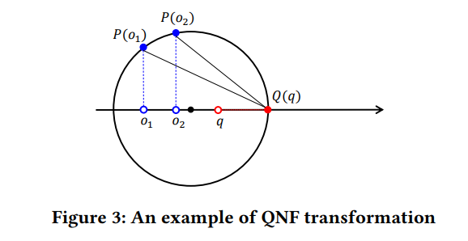



QNF-Transformation
Xbox Transformation
$$P\left(o\right)=\left[o,\sqrt{M^{2}−{\left|\left|o\right|\right|}^{2}}\right]$$
$$Q\left(q\right)=\left[q,0\right]$$
QNF Transformation
$$P\left(o\right)=\left[o,\sqrt{M^{2}−{\left|\left|o\right|\right|}^{2}}\right]$$
$$Q\left(q\right)=\left[λq,0\right], λ=\frac{M}{\left|\left|q\right|\right|}$$
Huang, Q., Ma, G., Feng, J., Fang, Q., & Tung, A.K. (2018). Accurate and Fast Asymmetric Locality-Sensitive Hashing Scheme for Maximum Inner Product Search. KDD.

Slide 26
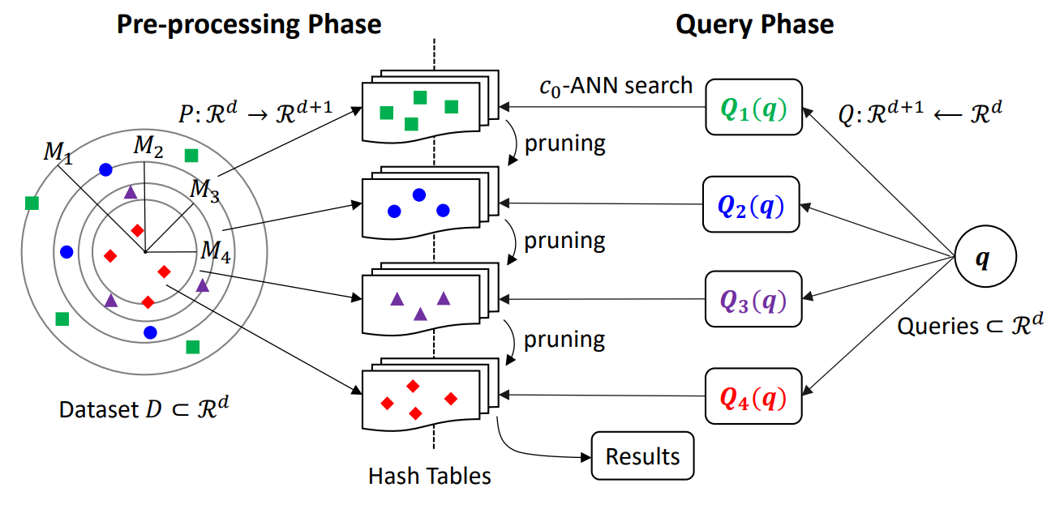
H2-ALSH Scheme
Huang, Q., Ma, G., Feng, J., Fang, Q., & Tung, A.K. (2018). Accurate and Fast Asymmetric Locality-Sensitive Hashing Scheme for Maximum Inner Product Search. KDD.

Slide 27
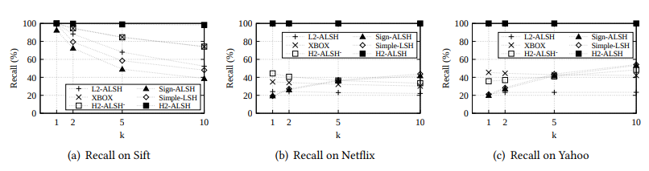
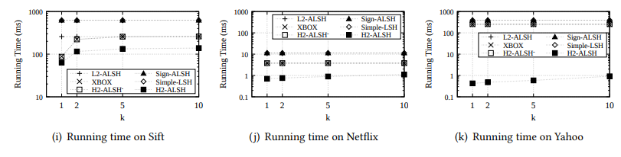
H2-ALSH Scheme
Huang, Q., Ma, G., Feng, J., Fang, Q., & Tung, A.K. (2018). Accurate and Fast Asymmetric Locality-Sensitive Hashing Scheme for Maximum Inner Product Search. KDD.

Slide 28
1.2 Indexing – Inverted Index

Slide 29
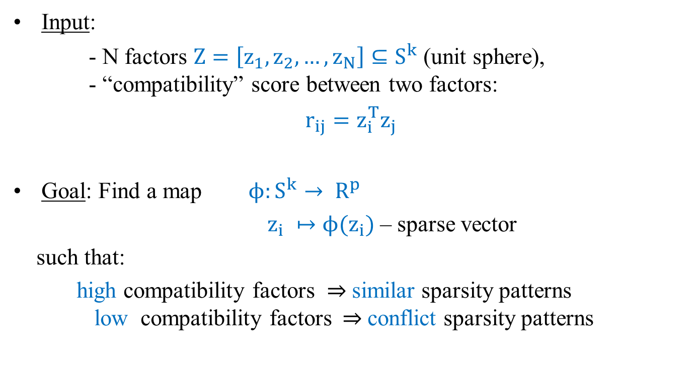
Idea 2: Sparsity Mapping + Inverted Index
Input:
- N factors $Z=\left[z_{1}, z_{2}, …, z_{N}\right]⊆S^{k}$ (unit sphere), - “compatibility” score between two factors:
$r_{ij}=z_{i}^{T}z_{j}$
Goal: Find a map $ϕ:S^{k}→ R^{p}$
$z_{i} ↦ϕ(z_{i})$ – sparse vector
such that:
high compatibility factors $⇒$similar sparsity patterns low compatibility factors$⇒$conflict sparsity patterns
Bhowmik, Avradeep et al. “Geometry Aware Mappings for High Dimensional Sparse Factors.” AISTATS (2016).

Slide 30
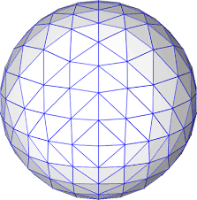
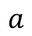
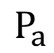

Idea 2: Sparsity Mapping + Inverted Index
$$P_{a}$$
$$a$$
Step 1:
Tessellating the unit sphere by $M$ vectors
$$Γ=\left\{a_{i} \right|i=1, 2, …, M, \left|\left|a_{i}\right|\right|=1\}$$
into many regions
$$γ_{a}=\{x∈S^{k}:d\left(a, x\right)≤d\left(a^{′},x\right) ∀ a^{′}∈Γ, a≠a′\}$$
Step 2: Associate each region $γ_{a}$with p-dimensional vector permutation $P_{a}$.

Slide 31
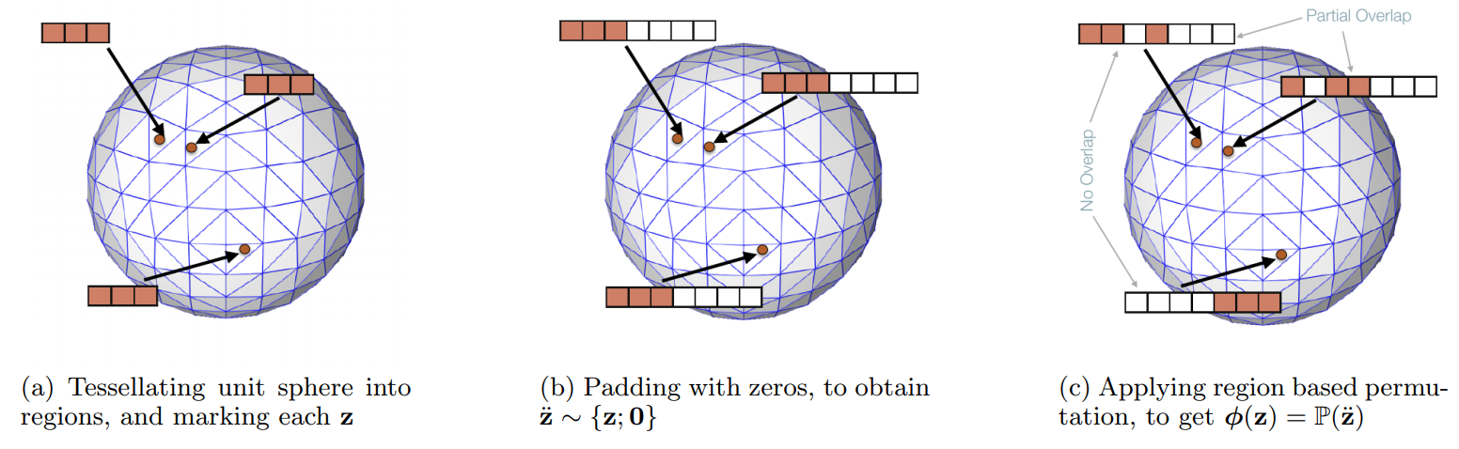
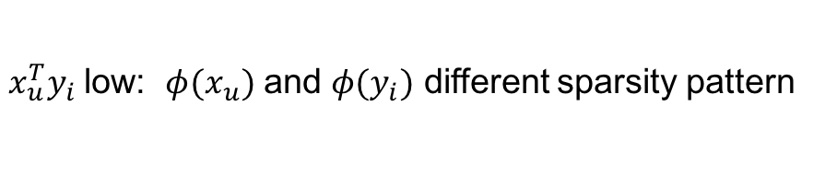
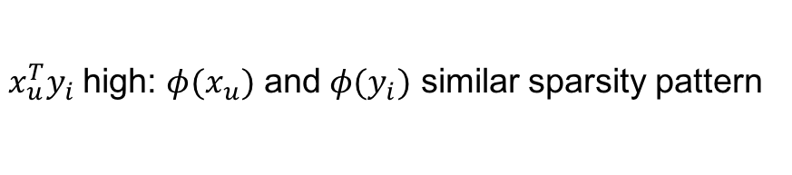
Idea 2: Sparsity Mapping + Inverted Index
(This picture is taken from (*))
User $u$ $→$ sparse vector $φ(x_{u})$
$x_{u}^{T}y_{i}$high: $φ(x_{u})$ and $φ(y_{i})$ similar sparsity pattern
Item $i$ $→$ sparse vector $φ(y_{i})$
$x_{u}^{T}y_{i}$low: $φ(x_{u})$ and $φ(y_{i})$ different sparsity pattern
Bhowmik, Avradeep et al. “Geometry Aware Mappings for High Dimensional Sparse Factors.” AISTATS (2016).

Slide 32
Sparse Factors and Inverted Index
User
3 | 0 | 0 | 1 | 0
conflict sparsity patterns
9 | 0 | 8 | 0 | 0
Index
1 | 2 | 3 | 4 | 5
0 | 6 | 0 | 7 | 3
Item 1
Item 2
Item 3
Item 1
Item 2
similar sparsity patterns
Item 4
Item 7
Item 2
Item 3
Item 7
9 | 0 | 8 | 0 | 0
Item 8
Item 8
Item 5
Item 8
3 | 0 | 1 | 0 | 0
Item 6
Bhowmik, Avradeep et al. “Geometry Aware Mappings for High Dimensional Sparse Factors.” AISTATS (2016).

Slide 33



Movielens
Histograms of percentage of discarded items over users

Slide 34

Movielens
Recovery Accuracy for Movielens

Slide 35
2. Sampling

Slide 36

Idea 5: Sampling
Ballard, G., Kolda, T.G., Pinar, A., & Comandur, S. Diamond Sampling for Approximate Maximum All-Pairs Dot-Product (MAD) Search. ICDM 2015

Slide 37

Motivating Example
Ballard, G., Kolda, T.G., Pinar, A., & Comandur, S. Diamond Sampling for Approximate Maximum All-Pairs Dot-Product (MAD) Search. ICDM 2015

Slide 38

Tripartite Graph for Binary Inputs
Ballard, G., Kolda, T.G., Pinar, A., & Comandur, S. Diamond Sampling for Approximate Maximum All-Pairs Dot-Product (MAD) Search. ICDM 2015

Slide 39

Diamond Sampling

Slide 40

Idea 5: Sampling

Slide 41

Idea 5: Sampling

Slide 42

Expectation on Diamond Samples

Slide 43

Idea 5: Sampling

Slide 44

Idea 5: Sampling

Slide 45
3. Sequential Scanning

Slide 46




Idea 4: Sequential Scanning with Upper-Bounding
$$q^{T}p≤\left|\left|q\right|\right|.\left|\left|p\right|\right|$$
Cauchy-Schwarz inequality
Li, H., Chan, T.N., Yiu, M.L., & Mamoulis, N. (2017). FEXIPRO: Fast and Exact Inner Product Retrieval in Recommender Systems. SIGMOD Conference.

Slide 47
4. Quantization-based

Slide 48



Idea 3: Quantization-based
Mapping each vector to a set of $K$ subspaces.
Length $\left\lfloor \frac{d}{K}\right\rfloor$
$${ x}_{u}=\left[x_{u}^{(1)} x_{u}^{(2)} …{ x}_{u}^{(K)}\right] ∀ u∈U$$
$$y_{i}=\left[y_{i}^{(1)} y_{i}^{(2)} … y_{i}^{(K)}\right] ∀i∈I$$
Guo, R., Kumar, S., Choromanski, K., & Simcha, D. (2016, May). Quantization based fast inner product search. In Artificial Intelligence and Statistics.

Slide 49













Idea 2: Quantization-based
Followed by independent quantization of data base vectors
in each subspace.
$$y_{i}=\left[y_{i}^{(1)} y_{i}^{(2)} … y_{i}^{(K)}\right] ∀i∈I$$
$$=$$
$$=$$
$$=$$
Codebooks:
$$C^{1}$$
$$C^{2}$$
$$C^{K}$$
learn from
data
$$×$$
$$×$$
$$×$$
$$α_{y_{i}}^{(1)}$$
$$α_{y_{i}}^{(2)}$$
$$α_{y_{i}}^{(K)}$$
One-hot:

Slide 50

Idea 2: Quantization-based
Approximate inner product with learned quantizers:
$${ x}_{u}^{T}y_{i}=\sum_{k}{x_{u}^{\left(k\right)T}y_{i}^{(k)}}$$
Guo, R., Kumar, S., Choromanski, K., & Simcha, D. (2016, May). Quantization based fast inner product search. In Artificial Intelligence and Statistics.

Slide 51

Idea 2: Quantization-based
Movielens
Guo, R., Kumar, S., Choromanski, K., & Simcha, D. (2016, May). Quantization based fast inner product search. In Artificial Intelligence and Statistics.

Slide 52

Idea 2: Quantization-based
Netflix
Guo, R., Kumar, S., Choromanski, K., & Simcha, D. (2016, May). Quantization based fast inner product search. In Artificial Intelligence and Statistics.

Slide 53

A Framework for an Efficient MIPS
Before any query request
Query-independent Data Structure Construction:
A preprocessing procedure is performed on the entire
item vectors $Y$ to construct a data structure $D$ to store information about $Y.$
Given a query $x_{u}$, there are two necessary steps:
Query-dependent pre-processing:
A pre-processing procedure for the query.
Yu, H., Hsieh, C., Lei, Q., & Dhillon, I.S. (2017). A Greedy Approach for Budgeted Maximum Inner Product Search. NIPS.

Slide 54

Essential Components for a Fast MIPS
Candidate Screening
An efficient procedure is performed to filter candidates $C_{u}$.
$\left|C_{u}\right|<n$
Candidate Ranking
An exact ranking is performed on the selected candidates $C_{u}$.
Time complexity: $O\left(\left|C_{u}\right|×k+\left|C_{u}\right|×\log\left(\left|C_{u}\right|\right)\right)$
Yu, H., Hsieh, C., Lei, Q., & Dhillon, I.S. (2017). A Greedy Approach for Budgeted Maximum Inner Product Search. NIPS.

Slide 55
Summary
Efficient recommendation retrieval can be achieved by approximate Maximum Inner Product Search
Approaches:
Indexing: LSH, Inverted Index
Sequential Scanning with Upper Bound
Sampling
Product Quantization

